Slide 1
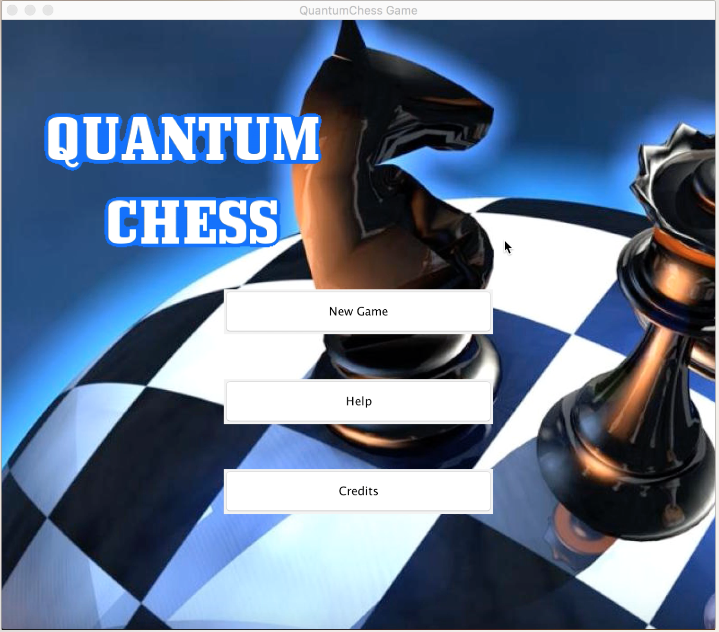
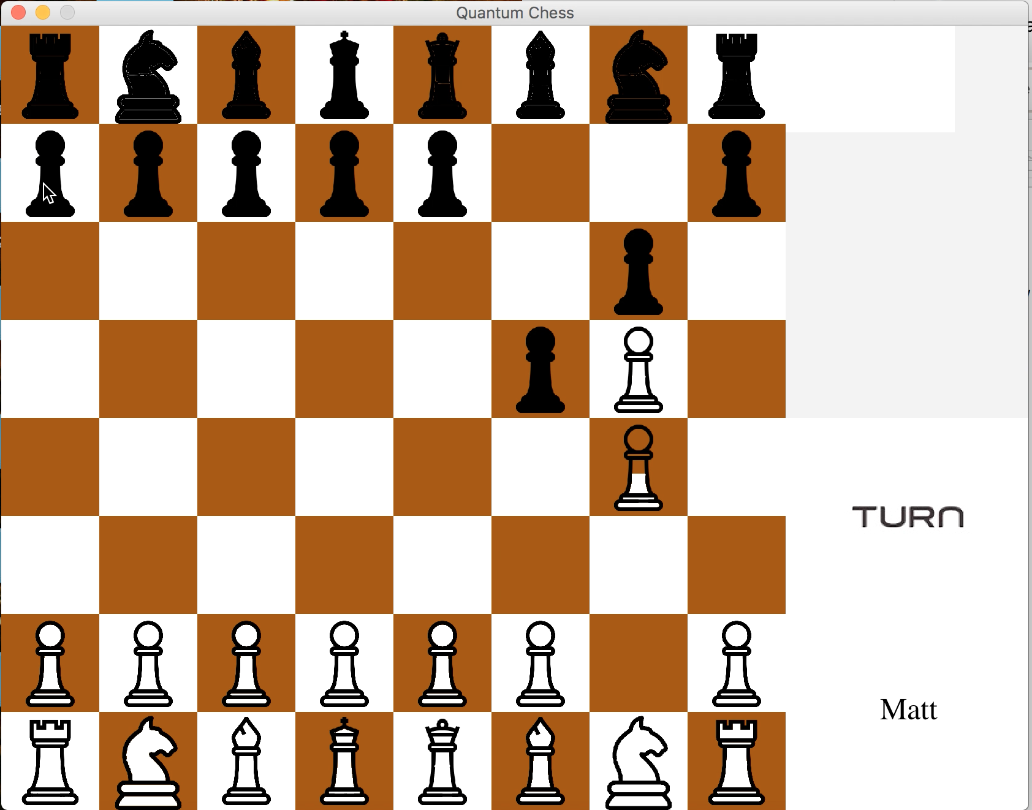
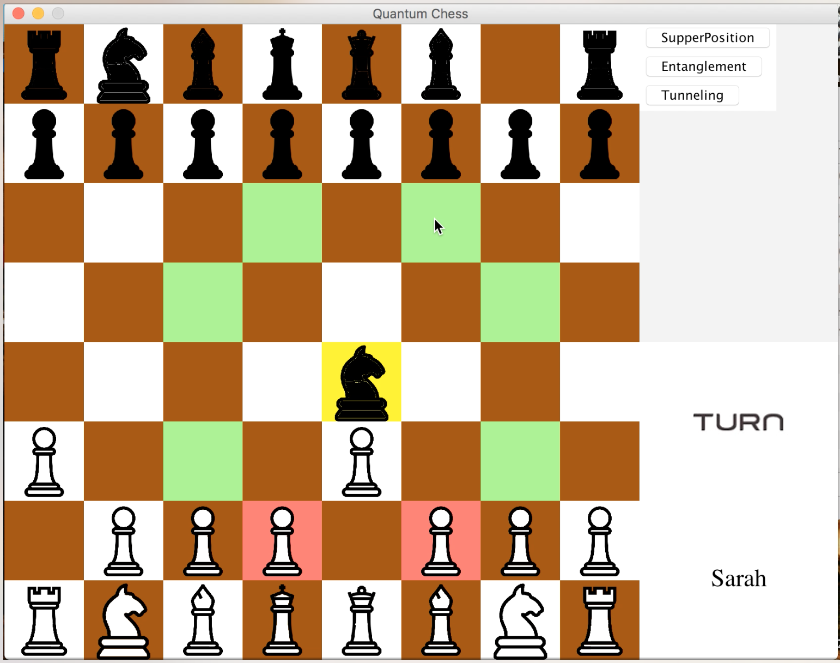
QuANTUM CHESS
Group 2-A

Slide 2
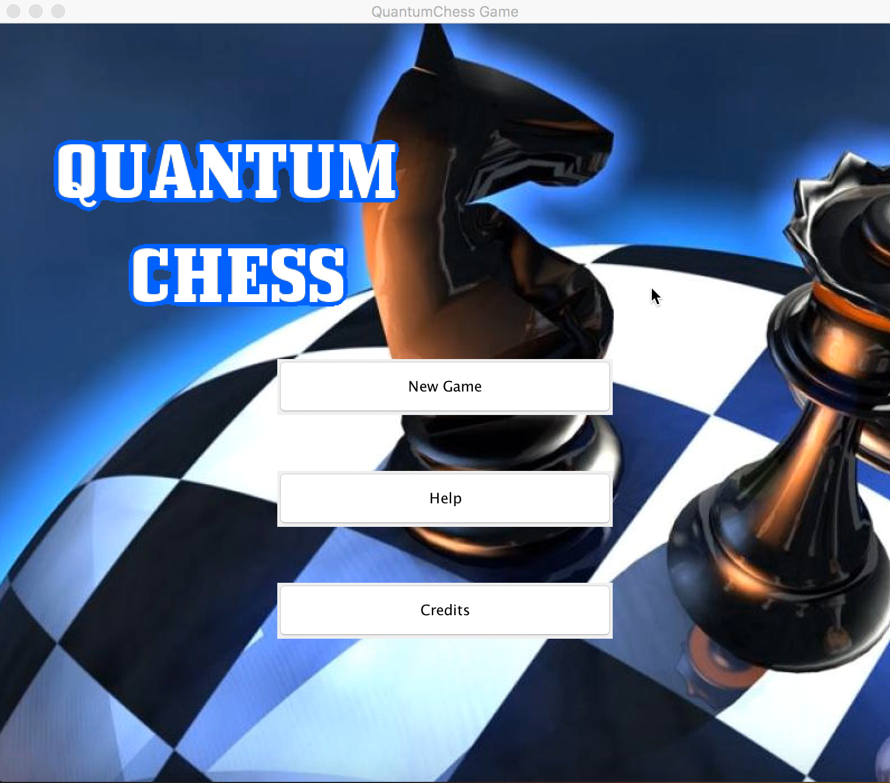
Entrance

Slide 3
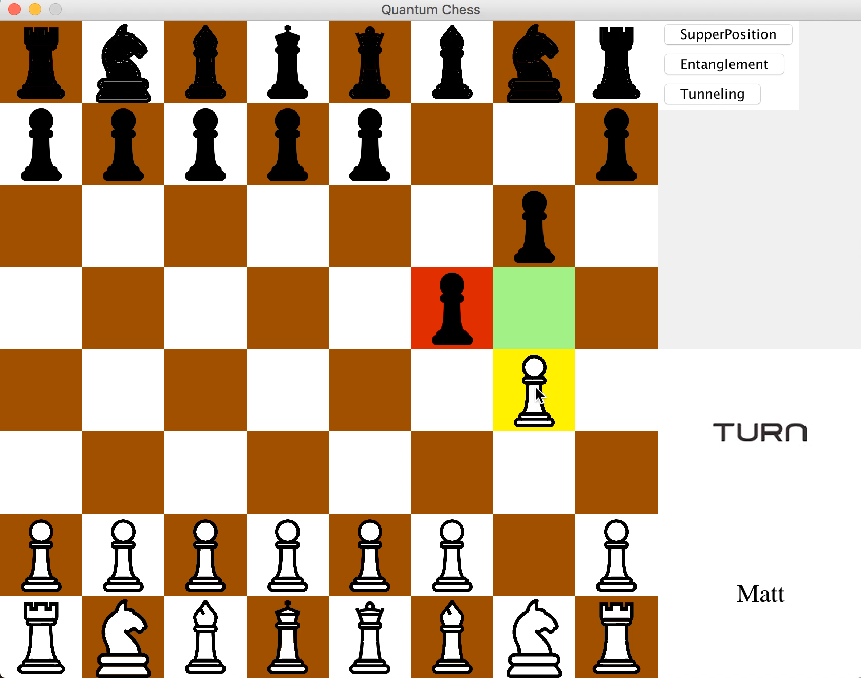
SUPERPOSITION

Slide 4


Slide 5
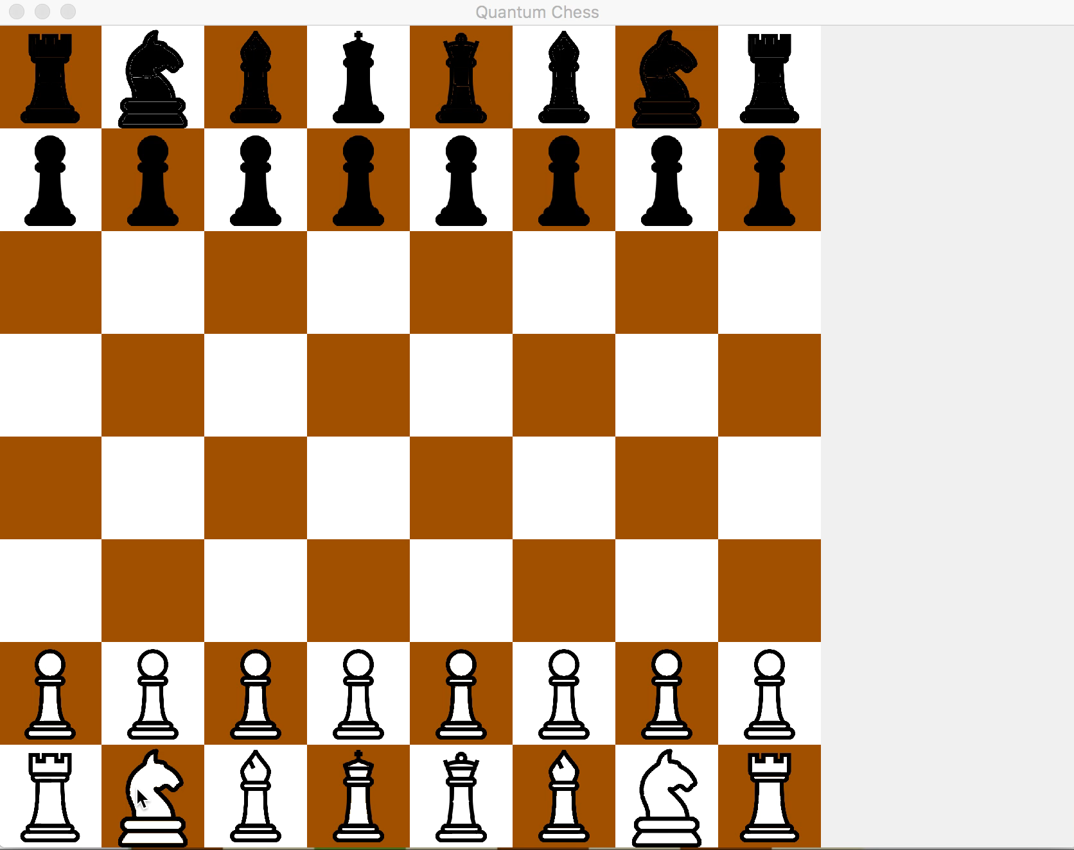
ENTANGLEMENT

Slide 6

TUNNELING

Slide 7
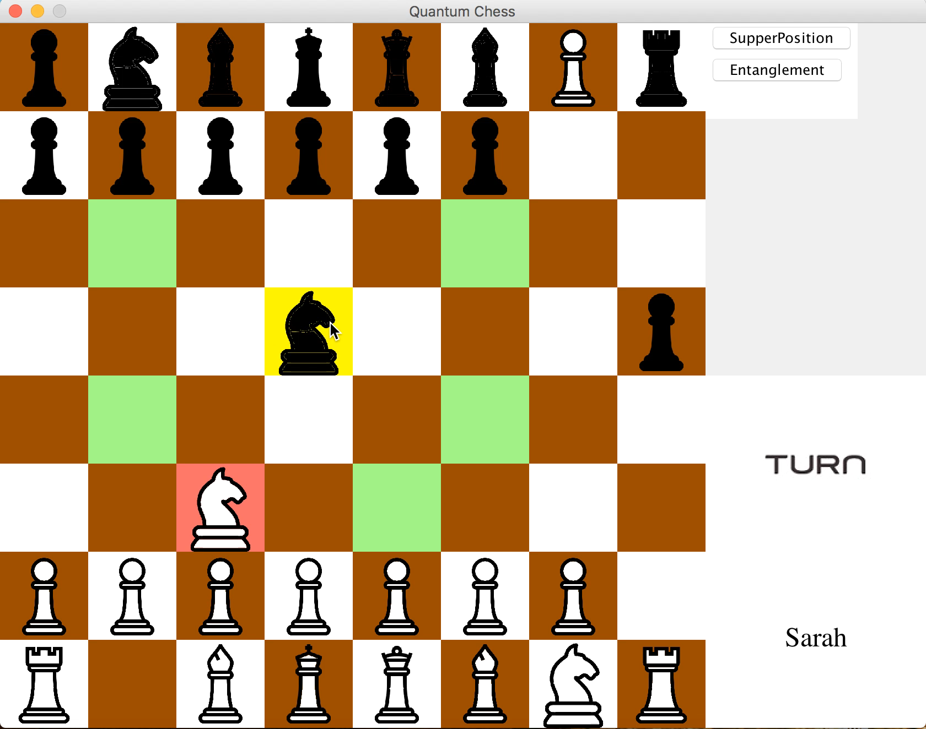
SWAP

Slide 8

SURRENDER

